Slide 1
How does a person become a Saint of the Roman Catholic Church?

Slide 2
INSTRUCTIONS:
Please read through the Power Point. Throughout the lesson are questions.
Answer each question and submit your answers via a Word Document or photo (jpg format) by January 31, 2021 at rfststephenps@yahoo.com

Slide 3
It is absolutely necessary that the person nominated for sainthood has passed away.
People who are still alive cannot be nominated – no matter how good they are!
The process can usually start approximately 5 years after someone dies.
This is to ensure that their case can be evaluated objectively.
The waiting period after death can be waved by the pope should he consider it necessary.

Slide 4
QUESTION #1
Why do you think that the Church requires that someone be dead before they can even be nominated for sainthood?

Slide 5
Once the five years are up, or a waiver is granted, the bishop of the diocese where the person died can open an investigation into the life of the individual, to see whether they lived their lives with sufficient holiness and virtue to be considered for sainthood.
Other religious groups in the diocese can also ask the bishop to open the investigation. For example: a community of nuns or brothers may do so.
Evidence is gathered on the persons' life and deeds, including witness testimonies.

Slide 6
If there is sufficient evidence, the bishop asks the Congregation for the Causes of Saints, the department that makes recommendations to the Pope on saints, for permission to open the case.
Once the case is accepted for consideration, the individual can be called a “Servant of God".

Slide 7
Question #2
The title “Servant of God” is very important especially to Pope Francis. As a matter of fact of the many titles that Pope Francis can be addressed his favorite is the title “Servant of the Servants of God”.
What do you think these two titles -- “Servant of God” and “Servant of the Servants of God” – implies about the importance the Roman Catholic Church places on service?

Slide 8
The Congregation for the Causes of Saints studies the evidence of the candidate's holiness, work and signs that people have been drawn to prayer through their example.
If the Congregation approves the case, it is passed to the Pope.
If the Pope decides that the person lived a life of "heroic virtue", they can then be called “Venerable".

Slide 9
Question #3
Has anyone ever “called you to prayer”. Maybe a grandparent or a friend has encouraged you to pray at a certain point in your life. Maybe they continue to work in your life as a “call to prayer”?
Briefly discuss why it is important that we are “called to prayer”.

Slide 10
Verified miracles
To reach the next stage, Beatification, a miracle needs to be attributed to prayers made to the individual after their death.
The prayers being granted are seen as proof that the individual is already in heaven, and hence able to intercede with God on someone’s behalf.

Slide 11
Incidents need to be verified by evidence before they are accepted as miracles.
For Example:
In the case of Pope John Paul II, Vatican experts examined the medical evidence for an allegedly miraculous cure from Parkinson's Disease of a 49 year old French nun – Sister Marie Simon-Pierre Normand.
Sister Marie said that she and her fellow nuns prayed for the intercession of Pope John Paul II after his death. Her sudden cure had no logical medical explanation, the Vatican says.

Slide 12
After beatification, the candidate is given the title “Blessed".
There is one exception to the miracle requirement - a martyr, someone who died for their faith, can be beatified without a verified miracle

Slide 13
Question #4
Why do you think the Church makes an exception to the proof of a miracle for those who were martyred?
If you were with us last year you might remember the lesson on San Pedro de Jesus Maldonado who was martyred in Mexico.

Slide 14
Canonization is the final step in declaring a deceased person a saint. To reach this stage, a second miracle normally needs to be attributed to prayers made to the candidate after they have been beatified.
Martyrs, however, only need one verified miracle to become a saint.
The second miracle in John Paul's case was the reported "inexplicable recovery" of Costa Rican woman Floribeth Mora from a serious brain illness, which was attributed to John Paul II's intercession.

Slide 15
Pope Francis took the unusual step of waiving the requirement of a second miracle in the case of John XXIII. This was said to be because of the widespread support for John XXIII's canonization, and the large number of miracles attributed to him.
During the canonization ceremony, the Pope conducts a special Mass, reading aloud the individual's life history and then chanting a prayer in Latin that declares the person a saint.

Slide 16
Modern canonization ceremonies can attract huge audiences. Hundreds of thousands of pilgrims can often attend.

Slide 17
The crowd at the Canonization of Sts. Pope John Paul II and Pope John XXIII

Slide 18
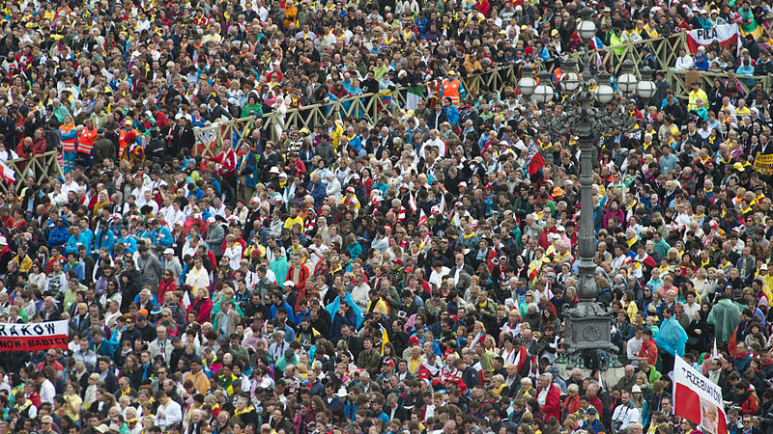

Slide 19
