Slide 1
Parent Session: Confirmation Year 1 and Communion Year 2
April 25, 2021
DUE DATE: May 2, 2021

Slide 2
IMPORTANT
This Parent Session is directed towards:
Confirmation Year 1 Parents
And
Communion Year 2 Parents
If you have a child in both of these sessions; you Only need to submit the work one time!

Slide 3
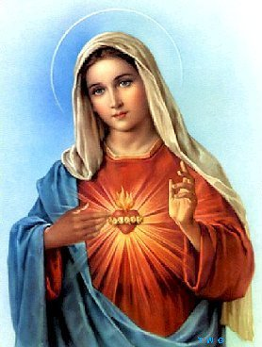
Mary The Mother of God

Slide 4
Assignment: You will view two YouTube videos
The 1st Video produced by CBS News “Who is the Virgin Mary” is a more secular video that is somewhat scholarly and very respectful towards Catholicism.
The 2nd Video produced by Ascension Presents with Fr. Mike “Why Catholics Call Mary Their Mother” is strictly from the Roman Catholic standpoint.

Slide 5
VIDEO #1: Who is the Virgin Mary
https://www.youtube.com/watch?v=ELT44kVzTS0

Slide 6
Video #2: “Why Catholics Call Mary Their Mother”
https://www.youtube.com/watch?v=pGRGv9_60iI

Slide 7
INSTRUCTIONS:
On the next slide there are 3 questions.
We ask that you watch the 2 videos first and then answer the questions openly and honestly.
You may submit a Word Document with your answers or handwrite your answers and submit a picture (jpg format).
For Question #3 you can either describe the image or cut and paste a picture of the image onto your Word Document.
Please email your work to: rfststephenps@yahoo.com by 9AM on Sunday May 2, 2021
Both on your answer sheet and in the subject line of the email include the following: Your Full Name, The Full Name of your Child and what course they are taking (either Confirmation Year 1 OR Communion Year 2)

Slide 8
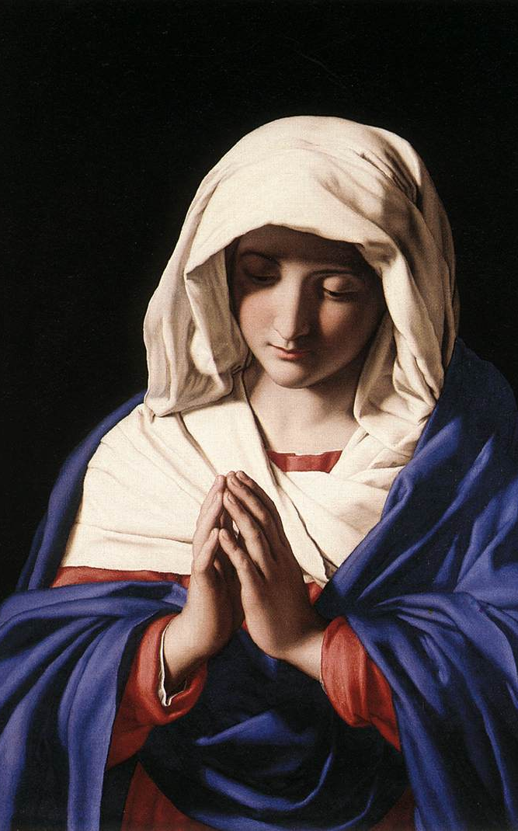
Please respond to the following questions
In the Second Video Fr. Mike Tells us that Jesus himself gave his mother to us as our mother -- Using the Apostle John as an example – that John took her into his home.
How does your family continue to welcome Mary into your home as your mother?
In the first Video; Fr. Neal Conolly says that Mary’s role is humanizing. She is someone we can relate to. Share with us a time in your life or the life of your family when Mary has been a comfort to you.
There are 1000’s upon 1000’s of images of the Virgin Mary in art. She is only mentioned 15 times in the Gospels yet aside from Jesus she is the most beloved figure in Roman Catholicism. Do a google search of the many images of Mary and let us know which one you (or your family) loves the most.

