Slide 1
Lent
Parent Session for Communion Year 2, Confirmation Year 1 and Confirmation Year 2
Weekend of February 27-28, 2021

Slide 2
Dear Families:
This Parent Session Power Point Lecture is for parents of children in Communion Year 1, Confirmation Year 1 and Confirmation Year 2.
You only need to submit work ONCE if you have children in more than one of these classes!
Please include in your email and responses: Your full name and the name/s of you child/children and what course they are taking.
Post this same information in the Subject Line of the email you send as well!
We are giving you 2 weeks to submit this assignment!
ALL of you will submit work by 9AM on March 21, 2021.
Email your responses to: rfststephenps@yahoo.com

Slide 3
Lent
Some Basics:
Lent lasts 40 days (kinda)
By the 9th Century Ash Wednesday became the official start day of Lent (it used to be the First Sunday of Lent).
But – the Sundays of Lent “do not count” because even during Lent on a Sunday we are celebrating the Resurrection of Christ!
Lent ends at sundown on Holy Thursday.
At sundown on Holy Thursday the Holy Thursday Mass begins and thus the Season known as the Triddum begins.
Does this make sense?
I hope so! ☺

Slide 4
What is Lent?
Lent is a time to reflect, repent and restore ourselves to God.
“During Lent, we seek the Lord in prayer by reading Sacred Scripture; we serve by giving alms; and we practice self-control through fasting. We are called not only to abstain from luxuries during Lent, but to a true inner conversion of heart as we seek to follow Christ's will more faithfully. We recall the waters of baptism in which we were also baptized into Christ's death, died to sin and evil, and began new life in Christ.” (United States Conference of Catholic Bishops www.usccb.org)

Slide 5
3 Main Lenten Themes!
Fast
Almsgiving
Prayer

Slide 6
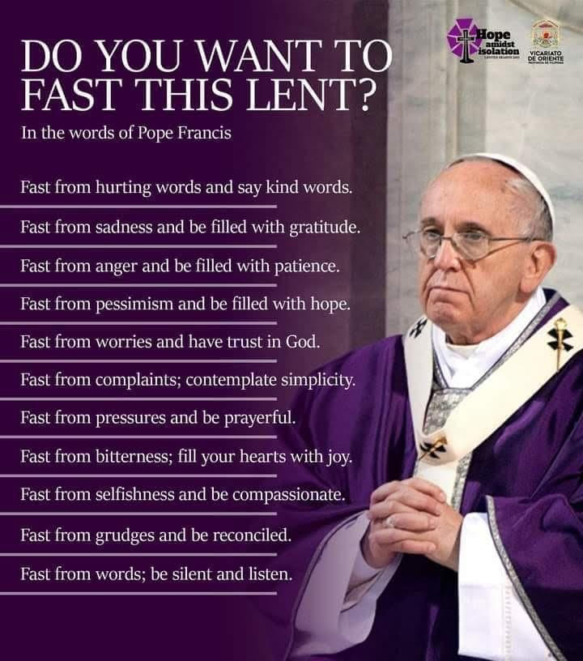
Fasting
Other ways to fast given to us by our Holy Father-Pope Francis!

Slide 7
Almsgiving
4 Reasons for Almsgiving by Fr. Mike Schmidt
https://www.youtube.com/watch?v=xODJuXGUyzQ
Watch the above video concerning Almsgiving!
Share your thoughts with your family concerning the video!

Slide 8
Prayer
For Communion Year 2 Families – Practice the assigned prayers with your children.
For all families – Pray together! Pray often!
Prayer does not need to be complicated.
If your family is not used to praying together; I suggest you start by praying before meals.
“Bless us O Lord, and these thy gifts which we are about to receive. From thou bounty through Christ our Lord! Amen!”

Slide 9
INSTRUCTIONS: Activity
1. Write out the 4 Reasons for Almsgiving that Fr. Mike gives us!
Work as a family! Find some paper or construction paper or even a poster board. Creatively display the 4 Reasons!
Feel free to use colors (Purple is the primary Lenten color!)
Then display your work somewhere in your house!
Maybe you have a home altar or just on the refrigerator is great!
Send us a picture of what you create as a family!
2. Plan a Lenten activity for your family.
Choose one of the 3 Themes from slide #4 and as a family take part in an activity together.
Take 2 pictures of your family working on the activity
Submit your 3 pictures via email to rfststephenps@yahoo.com by 9AM on Sunday, March 21, 2021

