Slide 1
Prayer & Home
Confirmation II Parent Session
April 25, 2021

Slide 2
Opening Prayer
Let us begin our prayer marked by the sign of our faith:
In the name of the Father, the Son, and the Holy Spirit.
Amen.
God our Father, you knew us before we were born. You called us at Baptism to be witnesses of your love for us in Christ. Prepare our hearts and minds today to welcome the gift of your Holy Spirit, that we may become everything you desire us to be as your sons and daughters in Christ.
In Jesus’ name we pray, Amen.

Slide 3
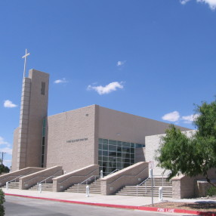
Retreat 2021
Your sons & daughters just experienced a spiritual awakening last weekend.
Now is the perfect opportunity to foster and grow this spirituality.
Your sons & daughters testified to God’s love.

Slide 4
Retreat 2021
If you haven’t already, talk to your sons & daughters about last weekend’s retreat.
Let them share their experiences and their emotions about their weekend experience.

Slide 5
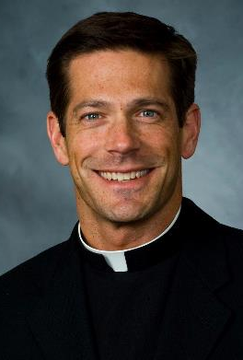
Father mike schmitz
“To be a parent is to be the first teacher of your child in the faith.”
“Their vision of what it is to be Catholic will be based off of your example.”

Slide 6
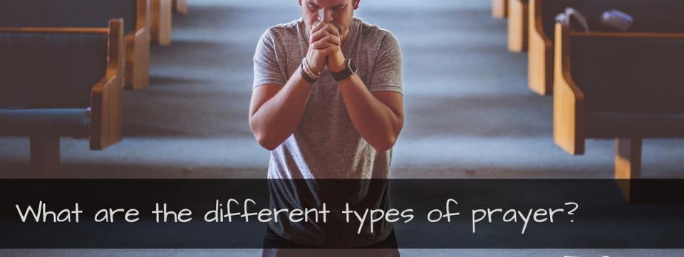
Traditional Prayers
Rosary
Meditating
Prayer in Silence
Singing
Talking with God Spontaneously

Slide 7
Reading Scripture
Preaching the Gospel
Pilgrimage or Prayer Walk
Journal Writing
Mass
Actions

Slide 9
Show your child how to be:
Grateful
Thankful
Pray before a meal

Slide 10
Listening
Teenagers want to be heard.
So many teenagers have told me over the years that their parents don’t listen to them; that they don’t feel comfortable talking to them about issues in their life.

Slide 11
Listening
As a parent, you should be the first person your sons and daughters go to with an issue in their life.
So many teenagers turn to their friends for advice or answers, and their peers are just as lost as they are.

Slide 12
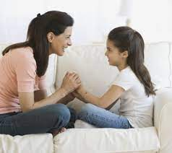
understanding
There is a big generational gap between adults and teenagers.
Today’s teenagers have grown up in a day and age unlike any in human history!

Slide 13
understanding
As adults, we have to stop comparing the way we were raised to how they are growing up today.
An issue we may consider to be small, can be life-changing for a teenager.

Slide 14
empathy
As adults, we forget what it was like to be a teenager.
Putting ourselves in our children’s shoes will allow us to better see how they feel in the world.

Slide 15
empathy
Suicide, depression, and anxiety are at an all-time high among teenagers.
Being empathetic to any issue your sons and daughters are experiencing can literally save their lives!

Slide 16
The best prayer is an act of love. At its root, it really should be deceptively, almost shockingly simple.

Slide 17
Listening, understanding, and being empathetic are all forms of prayer!!
Your sons and daughters will greatly benefit by seeing these three things coming from their parents.

Slide 18
Be present in your teenager’s life!

Slide 19
Closing Prayer
In the name of the Father, the Son, and the Holy Spirit.
Heavenly Father, as we come to the end of our time together, we thank you for what has been accomplished here today. Please give each of us the strength to be compassionate toward each other on a daily basis. Help us to move forward and allow us to grow in all areas of our lives. May we leave here recognizing that you are the God of all wisdom and you are willing to lead us forward.
In Jesus’ name we pray.
Amen.

